Slide 1
ATAI
Advanced Techniqueof Artificial Intelligence
ATAI
ChongqingUniversity _{AdvancedTechniqueof}
of Technology Artificial Intelligence
Chongqing University of
Technology
Chongqing University ^{ATAI}
_{of Technology} Advanced Techniqueof
Artificial Intelligence
Chongqing University of Technology
Chongqing University of Technology
Multi-Modality Spatio-Temporal Forecasting via Self-Supervised Learning
Multi-Modality Spatio-Temporal Forecasting via Self-Supervised Learning
Code:https://github.com/beginner-sketch/MoSSL
—— IJCAI 2024
Reported by Tingting Zhang
1

Slide 2
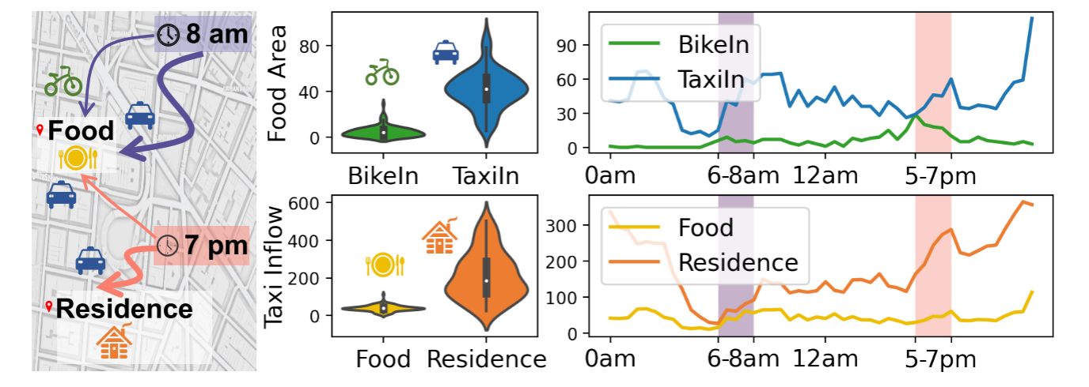
ATAI
AdvancedTechniqueof
Artificial Intelligence
ATAI
ChongqingUniversity _{AdvancedTechniqueof}
of Technology Artificial Intelligence
ChongqingUniversity of Technology
Motivation
(1) The first challenge lies in precisely obtaining variations and correlations of different modalities across time and space.
(2) The second challenge lies in accurately quantifying heterogeneous components to protect the model from erroneous pattern variations.
Notes:
挑战一：精确获取不同模态在时间和空间上的变化和关联性。传统的方法要么忽视了模态间的关联性，要么在模态内部和模态之间的特征上做了权衡。
挑战二：准确量化异质性成分，以防止模型受到错误模式变化的影响。以纽约市交通需求数据为例，不同模态在不同时间和地点的表现差异显著，这种异质性增加了MoST建模的不确定性和错误。
在图1中，我们描述了两种模态的观测结果（即自行车/出租车流入量）和相应的分布。调查结果表明，上午8点，两种模式均显示餐饮区的客流量有所增加，但出租车客流量明显超过自行车客流量;到晚上7点，出租车客流量在住宅区达到峰值，而餐饮区的客流量保持稳定。这种跨越空间、时间和模态的异质性放大了MoST建模中的不确定性和错误。

Slide 3
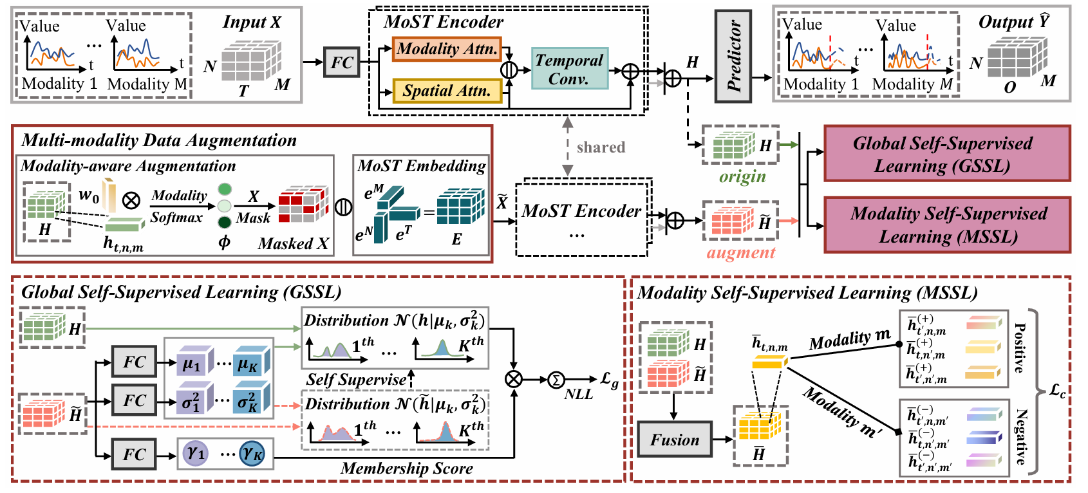
ChongqingUniversity of Technology
ATAI
AdvancedTechniqueof
Artificial Intelligence
ATAI
ChongqingUniversity _{AdvancedTechniqueof}
of Technology Artificial Intelligence
Overview

Slide 4
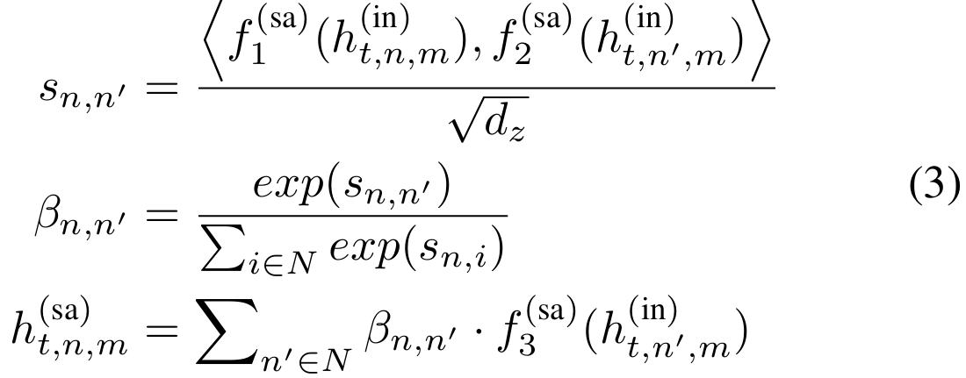
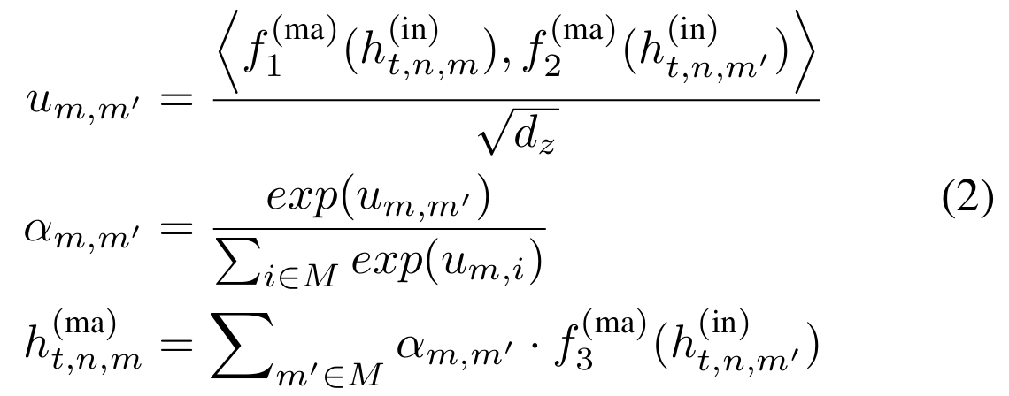
ChongqingUniversity of Technology
ATAI
AdvancedTechniqueof
Artificial Intelligence
ATAI
ChongqingUniversity _{AdvancedTechniqueof}
of Technology Artificial Intelligence
Method
1. Problem Statement
2.2 Spatial Attention
2. Multi-modality Spatio-Temporal Encoder
2.1 Modality Attention
2.3 Temporal Convolution

Slide 5
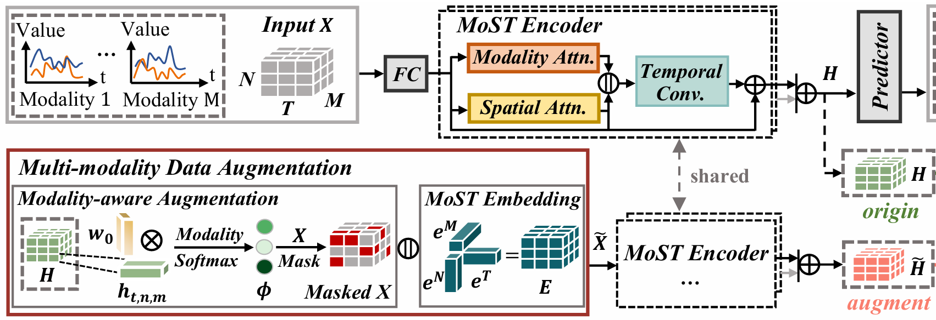
ChongqingUniversity of Technology
ATAI
AdvancedTechniqueof
Artificial Intelligence
ATAI
ChongqingUniversity _{AdvancedTechniqueof}
of Technology Artificial Intelligence
Method
3. Multi-modality Data Augmentation
3.1 Modality-aware Augmentation

Slide 6
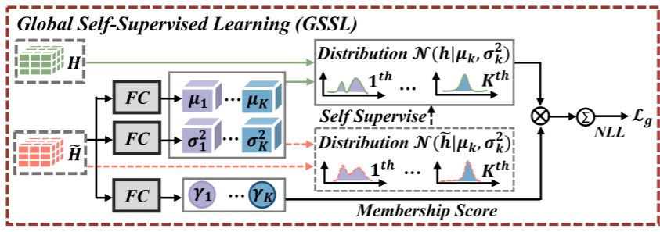
ChongqingUniversity of Technology
ATAI
AdvancedTechniqueof
Artificial Intelligence
ATAI
ChongqingUniversity _{AdvancedTechniqueof}
of Technology Artificial Intelligence
Method
4. Global Self-Supervised Learning

Slide 7
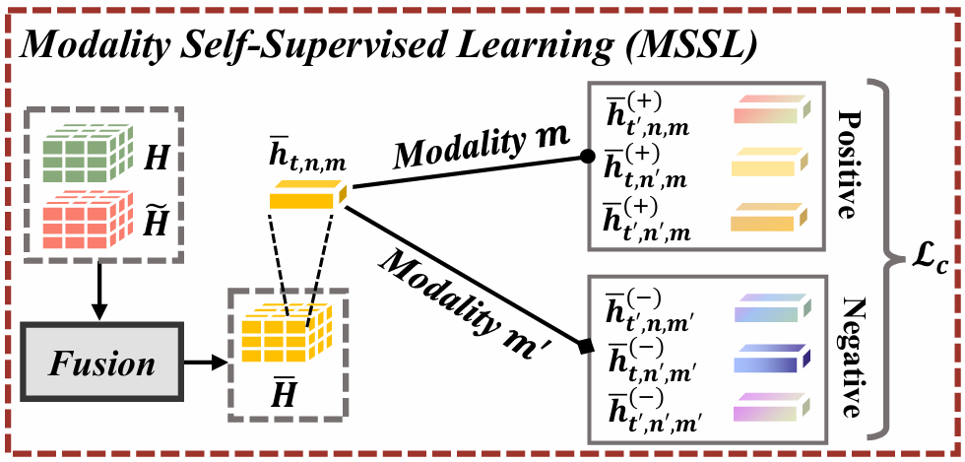
ChongqingUniversity of Technology
ATAI
AdvancedTechniqueof
Artificial Intelligence
ATAI
ChongqingUniversity _{AdvancedTechniqueof}
of Technology Artificial Intelligence
Method
5. Modality Self-Supervised Learning

Slide 8
ChongqingUniversity of Technology
ATAI
AdvancedTechniqueof
Artificial Intelligence
ATAI
ChongqingUniversity _{AdvancedTechniqueof}
of Technology Artificial Intelligence
Method
6. Model Optimization

Slide 9
ATAI
AdvancedTechniqueof
Artificial Intelligence
ATAI
ChongqingUniversity _{AdvancedTechniqueof}
of Technology Artificial Intelligence
ChongqingUniversity of Technology
Experiments

Slide 10
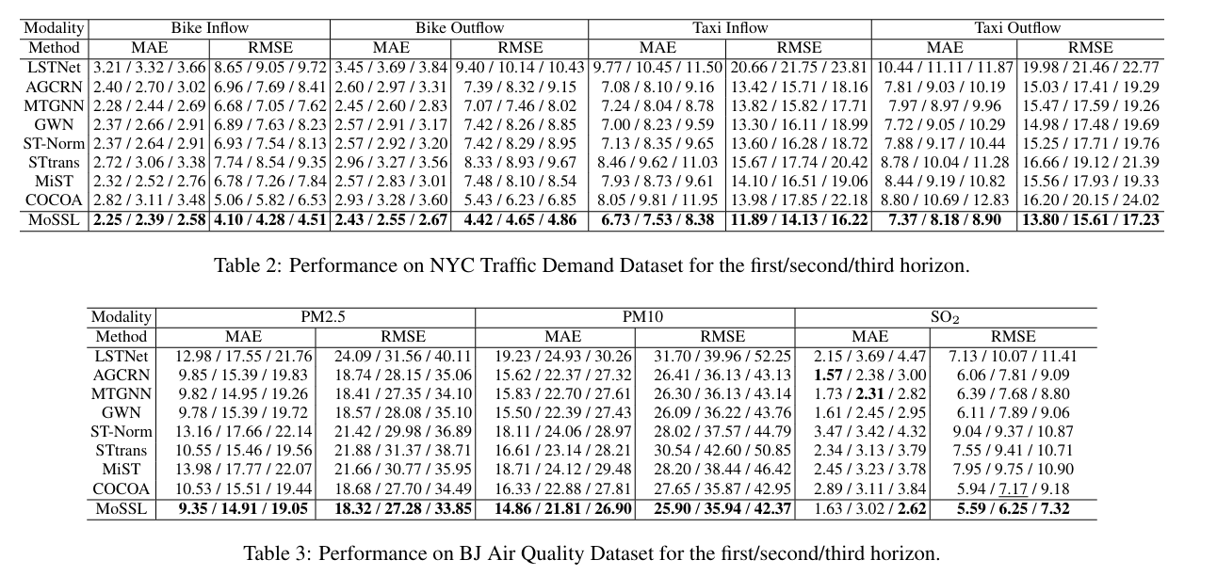
ATAI
AdvancedTechniqueof
Artificial Intelligence
ATAI
ChongqingUniversity _{AdvancedTechniqueof}
of Technology Artificial Intelligence
ChongqingUniversity of Technology
Experiments

Slide 11
ATAI
AdvancedTechniqueof
Artificial Intelligence
ATAI
ChongqingUniversity _{AdvancedTechniqueof}
of Technology Artificial Intelligence
ChongqingUniversity of Technology
Experiments

Slide 12
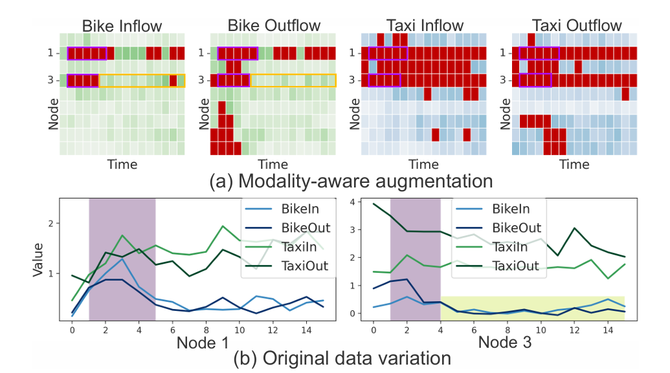
ATAI
AdvancedTechniqueof
Artificial Intelligence
ATAI
ChongqingUniversity _{AdvancedTechniqueof}
of Technology Artificial Intelligence
ChongqingUniversity of Technology
Experiments

Slide 13
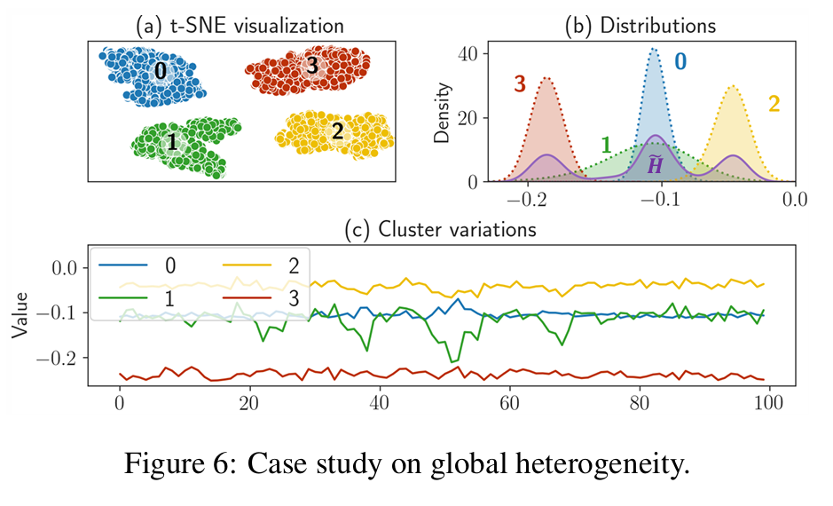
ATAI
AdvancedTechniqueof
Artificial Intelligence
ATAI
ChongqingUniversity _{AdvancedTechniqueof}
of Technology Artificial Intelligence
ChongqingUniversity of Technology
Experiments

Slide 14
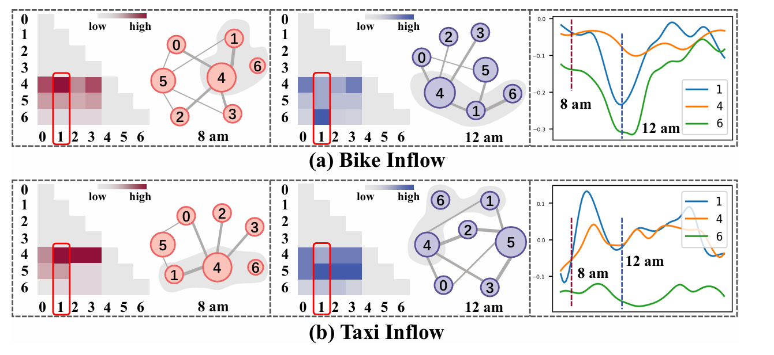
ATAI
AdvancedTechniqueof
Artificial Intelligence
ATAI
ChongqingUniversity _{AdvancedTechniqueof}
of Technology Artificial Intelligence
ChongqingUniversity of Technology
Experiments

Slide 15
ChongqingUniversity of Technology
ATAI
AdvancedTechniqueof
Artificial Intelligence
ATAI
ChongqingUniversity _{AdvancedTechniqueof}
of Technology Artificial Intelligence
Thanks!

